Slide 1
Obesity Prevention Policies in Low and Middle Income Countries (LMIC’s)
Barry Popkin
W. R. Kenan, Jr. Distinguished University Professor
Department of Nutrition
Gillings School of Global Public Health
School of Medicine
Department of Economics
The University of North Carolina at Chapel Hill

Slide 2
Outline: Why is this occurring?
Global obesity Dynamics
Major Global Driver: Dietary shifts, physical activity declines
How do we proceed: Mexican case study of comprehensive attack on obesity
Food sector options and examples across the LMIC’s
Future strategies and needs

Slide 3
State of Adult Female Obesity Across LMIC’s
Large shift away from undernutrition to overweight across all regions with some critical exceptions; acceleration annualized prevalence increase in rural overweight status.
The BMI distribution is shifting rightward and at high levels, increasing significantly. This represents an 8-10 kg increase in weight over a 10-18 year period in
many countries
Waist circumferences increasing at the same BMI level
Adolescents: not presented but much more complex picture with much more undernutrition-fear of intergenerational transmission of stunting/undernutrition. [paper under review]

Slide 4
National Percent Underweight and Overweight Prevalance in Most Recent Available Survey among Women
Aged 19-49 by Urban and Rural Residence, Sorted by 2010 per Capita Gross Domestic Product
Rural
Urban
Country (GDP)
Brazil (10993)
Turkey (10050)
Mexico (9128)
Kazakhstan (9070)
Gabon (8768)
Maldives (6570)
Colombia (6186)
Azerbaijan (5843)
Peru (5283)
Namibia (4876)
China (4433)
Jordan (4370)
Albania (3701)
Swaziland (3503)
Armenia (3031)
Guyana (2994)
Congo, Rep. (2970)
Indonesia (2952)
Guatemala (2873)
Morocco (2795)
Egypt (2698)
Honduras (2019)
Bolivia (1979)
Moldova (1632)
Nicaragua (1456)
Nigeria (1443)
India (1375)
Ghana (1319)
Zambia (1252)
Vietnam (1224)
Sao Tome and Principe (1215)
Cote d'Ivoire (1161)
Cameroon (1144)
Mauritania (1045)
Senegal (1034)
Lesotho (1004)
Kyrgyz Rep. (880)
Cambodia (795)
Kenya (795)
Timor-Leste (766)
Chad (761)
Benin (741)
Tajikistan (740)
Bangladesh (675)
Haiti (664)
Mali (613)
Zimbabwe (591)
Burkina Faso (536)
Nepal (535)
Togo (530)
Rwanda (529)
Tanzania (527)
Uganda (515)
Guinea (474)
Madagascar (427)
Mozambique (394)
Malawi (362)
Niger (349)
Sierra Leone (325)
Liberia (324)
Ethiopia (320)
Burundi (242)
Congo, Dem. Rep. (199)
Country (GDP)
Brazil (10993)
Turkey (10050)
Mexico (9128)
Kazakhstan (9070)
Gabon (8768)
Maldives (6570)
Colombia (6186)
Azerbaijan (5843)
Peru (5283)
Namibia (4876)
China (4433)
Jordan (4370)
Albania (3701)
Swaziland (3503)
Armenia (3031)
Guyana (2994)
Congo, Rep. (2970)
Indonesia (2952)
Guatemala (2873)
Morocco (2795)
Egypt (2698)
Honduras (2019)
Bolivia (1979)
Moldova (1632)
Nicaragua (1456)
Nigeria (1443)
India (1375)
Ghana (1319)
Zambia (1252)
Vietnam (1224)
Sao Tome and Principe (1215)
Cote d'Ivoire (1161)
Cameroon (1144)
Mauritania (1045)
Senegal (1034)
Lesotho (1004)
Kyrgyz Rep. (880)
Cambodia (795)
Kenya (795)
Timor-Leste (766)
Chad (761)
Benin (741)
Tajikistan (740)
Bangladesh (675)
Haiti (664)
Mali (613)
Zimbabwe (591)
Burkina Faso (536)
Nepal (535)
Togo (530)
Rwanda (529)
Tanzania (527)
Uganda (515)
Guinea (474)
Madagascar (427)
Mozambique (394)
Malawi (362)
Niger (349)
Sierra Leone (325)
Liberia (324)
Ethiopia (320)
Burundi (242)
Congo, Dem. Rep. (199)
Underweight
Percentage
Overweight
Underweight
Percentage
Overweight
Sample size: 290,278 rural, 232,581 urban source: Jaacks and Popkin, in process

Slide 5
Figure 2. Regional Percent Underweight and Overweight Prevalence in Most Recent Available Survey among
Women Aged 19-49 by Urban and Rural Residence, Weighted by 2010 Population
Rural
Urban
Underweight
Overweight
Underweight
Overweight
East Asia
and Pacific
East Asia
and Pacific
Eastern Europe and
Central Asia
Eastern Europe and
Central Asia
Latin America and
the Caribbean
Latin America and
the Caribbean
Middle East and
North Africa
Middle East and
North Africa
South Asia
South Asia
Sub-Saharan
Africa
Sub-Saharan
Africa
Percentage
Sample size: 290,278 rural, 232,581 urban
source: Jaacks and Popkin, in process

Slide 6
National Annualized Absolute Change in Percent Underweight and Overweight Prevalence among Women Aged 19-49
by Urban and Rural Residence in the most recent period, Sorted by 2010 Per Capita Gross Domestic Product
Rural
Urban
Country (GDP)
Brazil (10993)
Turkey (10050)
Mexico (9128)
Gabon (8768)
Colombia (6186)
Peru (5283)
China (4433)
Jordan (4370)
Armenia (3031)
Congo, Rep. (2970)
Indonesia (2952)
Egypt (2698)
Honduras (2019)
Bolivia (1979)
Nicaragua (1456)
Nigeria (1443)
India (1375)
Ghana (1319)
Zambia (1252)
Cote d'Ivoire (1161)
Cameroon (1144)
Senegal (1034)
Lesotho (1004)
Cambodia (795)
Kenya (795)
Benin (741)
Bangladesh (675)
Haiti (664)
Mali (613)
Zimbabwe (591)
Burkina Faso (536)
Nepal (535)
Rwanda (529)
Tanzania (527)
Uganda (515)
Guinea (474)
Madagascar (427)
Mozambique (394)
Malawi (362)
Niger (349)
Ethiopia (320)
Country (GDP)
Brazil (10993)
Turkey (10050)
Mexico (9128)
Gabon (8768)
Colombia (6186)
Peru (5283)
China (4433)
Jordan (4370)
Armenia (3031)
Congo, Rep. (2970)
Indonesia (2952)
Egypt (2698)
Honduras (2019)
Bolivia (1979)
Nicaragua (1456)
Nigeria (1443)
India (1375)
Ghana (1319)
Zambia (1252)
Cote d'Ivoire (1161)
Cameroon (1144)
Senegal (1034)
Lesotho (1004)
Cambodia (795)
Kenya (795)
Benin (741)
Bangladesh (675)
Haiti (664)
Mali (613)
Zimbabwe (591)
Burkina Faso (536)
Nepal (535)
Rwanda (529)
Tanzania (527)
Uganda (515)
Guinea (474)
Madagascar (427)
Mozambique (394)
Malawi (362)
Niger (349)
Ethiopia (320)
Underweight
Percentage
Overweight
Underweight
Percentage
Overweight
source: Jaacks and Popkin, in process
Notes:
ationa

Slide 7
Figure 4. Regional Annualized Change Absolute Change in Percent Underweight and Overweight Prevalence in the most recent period in Percent Underweight and Overweight among Women Aged 19-49 by Urban and Rural Residence, Weighted by 2010 Population
Rural
Urban
Underweight
Overweight
Underweight
Overweight
East Asia
and Pacific
East Asia
and Pacific
Eastern Europe and
Central Asia
Eastern Europe and
Central Asia
Latin America and
the Caribbean
Latin America and
the Caribbean
Middle East and
North Africa
Middle East and
North Africa
South Asia
South Asia
Sub-Saharan
Africa
Sub-Saharan
Africa
Percentage
source: Jaacks and Popkin, in process

Slide 8
Difference in Annualized Prevalence [recent minus earlier] by region recent minus earlier Percent Underweight and Overweight among Women
Aged 19-49 by Urban and Rural Residence, Sorted by 2010 per Capita Gross Domestic Product
Rural
Urban
Underweight
Overweight
Underweight
Overweight
East Asia
and Pacific
East Asia
and Pacific
Eastern Europe and
Central Asia
Eastern Europe and
Central Asia
Latin America and
the Caribbean
Latin America and
the Caribbean
Middle East and
North Africa
Middle East and
North Africa
South Asia
South Asia
Sub-Saharan
Africa
Sub-Saharan
Africa
Percentage
Sample 510, 598 rural; 440, 701 urban
source: Jaacks and Popkin, in process

Slide 9
Difference in Annualized Prevalence by region [recent minus earlier] in Percent Underweight and Overweight among Women Aged 19-49
by Urban and Rural Residence, Sorted by 2010 per Capita Gross Domestic Product
Rural
Urban
Country (GDP)
Brazil (10993)
Turkey (10050)
Mexico (9128)
Colombia (6186)
Peru (5283)
China (4433)
Jordan (4370)
Indonesia (2952)
Egypt (2698)
Bolivia (1979)
Nigeria (1443)
Ghana (1319)
Zambia (1252)
Cote d'Ivoire (1161)
Cameroon (1144)
Senegal (1034)
Cambodia (795)
Kenya (795)
Benin (741)
Bangladesh (675)
Haiti (664)
Mali (613)
Zimbabwe (591)
Burkina Faso (536)
Nepal (535)
Rwanda (529)
Tanzania (527)
Uganda (515)
Madagascar (427)
Mozambique (394)
Malawi (362)
Niger (349)
Ethiopia (320)
Country (GDP)
Brazil (10993)
Turkey (10050)
Mexico (9128)
Colombia (6186)
Peru (5283)
China (4433)
Jordan (4370)
Indonesia (2952)
Egypt (2698)
Bolivia (1979)
Nigeria (1443)
Ghana (1319)
Zambia (1252)
Cote d'Ivoire (1161)
Cameroon (1144)
Senegal (1034)
Cambodia (795)
Kenya (795)
Benin (741)
Bangladesh (675)
Haiti (664)
Mali (613)
Zimbabwe (591)
Burkina Faso (536)
Nepal (535)
Rwanda (529)
Tanzania (527)
Uganda (515)
Madagascar (427)
Mozambique (394)
Malawi (362)
Niger (349)
Ethiopia (320)
Underweight
Percentage
Percentage
Overweight
Underweight
Overweight
Sample 510, 598 rural; 440, 701 urban
source: Jaacks and Popkin, in process

Slide 10
Two other major shifts
Rightward shift in the BMI distribution among LMIC’s adults, especially women but where have male data find often similar pattern (e.g China)
Mysterious challenge: WC/BMI ratio increasing in many countries

Slide 11
Predicted BMI Increases Across Selected Countries at the
95th Centile in Age 30 and 40 Year Old Women*
*Based on quantile regression from nationally representative surveys of all countries except China
Source: Popkin and Slining (2013) Obes Reviews 2013; 14: 11-20.; see Stern et al, in process.

Slide 12
Female Waist Circumferences are Increasing at the Same
BMI Level Across Many Countries: The China Example
See Stern et al, under revise/resubmissions status

Slide 13
Male Waist Circumferences are Increasing at the Same
BMI Level Across Many Countries: The China Example
See Stern et al, under revise/resubmissions status

Slide 14
2. Energy Imbalance: Physical Activity declines in LMIC’s represent a significant, large component of the energy imbalance.
In countries with detailed longitudinal data on all components of physical activity we find very large declines in METS and any other measure of activity
Slow downward shift in high income countries starting from much lower starting point relative to high METS starting point and very steep decline in LMIC’s
See review across a number of low and high income countries by Ng and Popkin Obes Rev 2012

Slide 15
US Adults Met-hours Per Week of All Physical Activity, and Hours/Week of Time in Sedentary Behavior: Measured for 1965-2009 and Forecasted for 2010-2030
Source: Ng S.W. & Popkin B.M. Obesity Reviews 13 (8):659-80

Slide 16
UK Adults Met-hours per Week of Physical Activity and Hours/Week of Time in Sedentary Behavior: Measured for 1961-2005 and Forecasted for 2006-2030
Source: Ng S.W. & Popkin B.M. Obesity Reviews 13 (8):659-80

Slide 17
Brazilian Adults Met-hours per Week Of Physical Activity & Hours/Week Of Time In Sedentary Behavior: Measured For 2002-2008 And Forecasted For 2009-2030
Source: Ng S.W. & Popkin B.M. Obesity Reviews 13 (8):659-80

Slide 18
Chinese Adults Met-hours per Week of Physical Activity & Hours/Week of Time in Sedentary Behavior: Measured for 1991-2009 and Forecasted for 2010-2030
1991: 399 MET-hr/week
Source: Ng S.W. & Popkin B.M. Obesity Reviews 13 (8):659-80

Slide 19
Why the concern about movement and activity?
Important direct health benefits(other than energy balance)
  kids: enhances learning in a vast array of ways
  adults: improved bone health, prevention of diabetes and cardiovascular health, healthier aging, prevention of 4-5 different cancers
Difficult to stop the major declines in energy expended in market and home production, transportation nor to control increases in sedentary activity
In LMIC’s few systematic government attempts to increase physical activity other than in schools to date.
Little evaluation of voluntary efforts (e.g Agita Sao Paulo)

Slide 20
Sources of Major Global Dietary Shifts
Global increases in:
  Caloric sweetener use, especially in beverages but increasingly in all consumer packaged foods
  animal source foods
  refined carbohydrates, ultra refined highly processed foods
  Convenience eating/foods: snacking, away-from-home eating, precooked food
Global decreases in:
  legumes, vegetables, fruits in most countries
  food preparation time
Only in Low and middle income world: large increased edible oil use and food frying

Slide 21

Major Food System Shifts : Linkages from
Farm to Food Sales are Rapidly Shifting
The value chain is rapidly shifting toward vertical integration
Rapid transition to modern system varied across Latin America, Africa, Asia at various times over 1980-2010
  Modern: farmer to food processors or supermarkets
  Consolidation of food system resources is happening in most countries
Latin America: shift from 15-20% of all peso on food from modern supermarkets to 60% in 1990-2000 period
Top 5 chains control two-thirds of the supermarket sector in Latin America (Wal-Mart, Carrefour, Ahold)

Slide 22
Shift In Growth and Size of Sales for
a Subset of Retailers in Asia
First wave South Korea($42B), Taiwan
  Annual compound sales growth 2001-09: 10-12%
Second wave: Indonesia, Malaysia, Philippines, Thailand ($18B)
  Annual compound sales growth 2001-09: 13-18.5%
Third wave: China($91B), India, Vietnam
  Annual compound sales growth 2001-09: 28-50%
Current growth is very rapid in all markets where any opportunities are found. Rapid translation north-south by all global food system players—be they based in high or low and middle income countries

Slide 23
3. The Global LMIC’s Response: Mexico’s Integrated Systematic Response
Faced rapid increase in obesity, high caloric beverage intake, aggressive marketing, confusing use of GDA’s in food labeling by industry to confuse consumers
First beverage guidelines panel led to gov’t action in food-related programs
Second, systematic National Agreement for Healthy Nutrition (ANSA) coordinated by INSP, Cuernevaca approved by previous President, all cabinet—this was very comprehensive and specific with each agency assigned selected activities

Slide 24


Mexico’s Beverage Recommendations For Adults
Recommended kcals
Consumed for Women
Recommended kcals
Consumed for Men
1 GLASS
LOW SUGAR
AGUA FRESCA
(20 KCAL)
2 CUPS
UNSWEETENED
COFFEE
(10 KCALS)
TOTAL 187 KCALS
TOTAL 231 KCALS
1/2 BEER (180ML)
OR 1 GLASS RED
WINE (100ML)
(75 KCAL)
½ GLASS UNSWEETENED
FRUIT JUICE (54 KCALS)
2 GLASSES LOW SUGAR
AGUA FRESCA (40 KCAL)
1 CUP REDUCED FAT MILK (103 KCALS)
½ GLASS UNSWEETENED
FRUIT JUICE (54 KCALS)
2 CUPS
UNSWEETENED
COFFEE
(10 KCALS)
1/2 CUP REDUCED
FAT MILK (52 KCALS)
6-8 GLASSES OF WATER (0 Kcal)
6-8 GLASSES OF WATER (0 Kcal)

Slide 25
Ministry Of Health Response
10 Objectives to prevent Chronic Diseases
Promote physical activity (in school, work community, leisure environments)
Increase availability, access and consumption of water
Reduce consumption of sugar and fat in beverages*
Increase consumption of vegetables and fruits, legumes, hole grains and fiber in the diet
Improve the capacity for decision making for a healthy diet (nutrition literacy) *
Promote and protect exclusive breast-feeding until 6 months of age and adequate complementary feeding starting at 6 months of age
Reduce the quantity of added sugar in industrialized foods*
Reduce consumption of saturated fats and eliminate consumption and production of trans fats of industrial origin*
Reduce portion sizes of dishes, snacks and industrialized foods in restaurants and sale points*
Limit the quantity of added sodium in foods and reduce its consumption*
* Actions in which industry cooperation and participation and social responsibility are needed

Slide 26
Mexico (cont)
Third, very drawn out negotiations with food industry to create school guidelines for healthy nutrition with major reductions in SSB’s and junk food for children
Fourth, national panel formed by Ministries of Health and Finance and the Mex FDA (COFEPRIS) to develop Front-of-pack labeling system
Then election, new conservative government but one senate led by more left-oriented party

Slide 27
Mexico (cont)
2012-13: funding of civil society coalition, lobbyist, and research by Bloomberg Philanthropies provided the resources for civil society to build on national anti-SSB work and fight large Big Beverage push against taxation (previously lost 2 votes for 20% tax)
A long bitter campaign ensued[see next slides]
The role of very active civil society with funding for counter ads, press, very important. President forced to propose 10% tax to counter push for 20%
Also surprisingly gov’t created 8% junk food tax

Slide 28

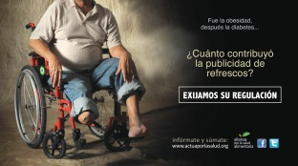





THE MEXICAN SSB TAX TIMELINE
COALITION BUILDING
EARNED MEDIA
EXPERT FORUMS
ALLIANCE BORN
INDUSTRY
CAMPAIGNS
PRINT AD BATTLE IN THE PRESS
CAMPAIGNS
JUNE
JULY
MAY
AUG
OCT
APR
MAR
FEB
JAN
DEC
OCT
SEPT
NOV
NOV
“FIRST CAME OBESITY, THEN DIABETES”
“12 SPOONFULS OF SUGAR”
“A HEALTHIER MEXICO”
“SUGARY DRINKS”
“WATER IS LIFE”
CONGRESS IN SESSION
CONGRESS IN SESSION
CONGRESS IN SESSION
COLLECT SIGNATORIES TO SSB TAX BILL
SSB TAX BILL INTRODUCED IN SENATE – “TABLED” TIL FISCAL REFORM
KEY DIALOGUE WITH MINISTRY OF FINANCE
INTENSE LOBBYING
ACADEMIA LAUNCH OF POLICY RECOM’S
PEÑA NIETO ANNOUNCES SODA TAX IN FISCAL REFORM
SSB TAX PASSED
NEW PRESIDENT TAKES OFFICES

Slide 29
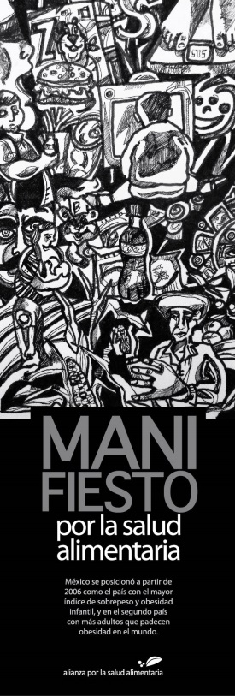


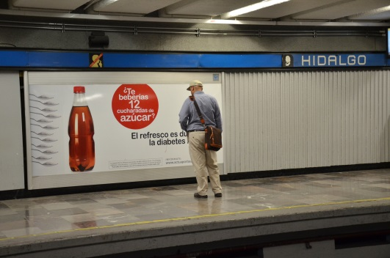

CAMPAIGN STRATEGY (1)
Coalition building: Create the Nutritional Health Alliance with former and new allies (diverse member base) and a shared, comprehensive agenda on malnutrition and obesity
Evidence based: Reports, arguments and proposals; draw from soda tax modeling and academic policy recommendations (National Institute of Public Health, et al); forums with experts; public opinion polls
Public campaigns: Expose the human drama of diabetes; stigmatize SSBs; promote soda tax and drinking fountains. Recurring theme: “Soda is sweet. Diabetes isn’t.”

Slide 30
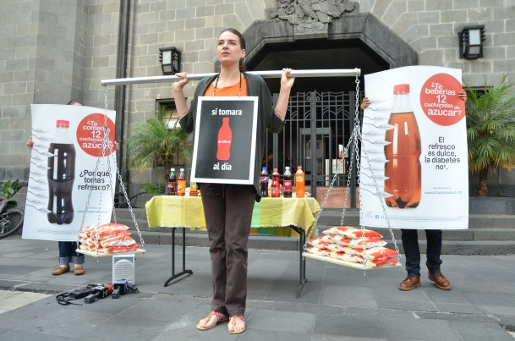
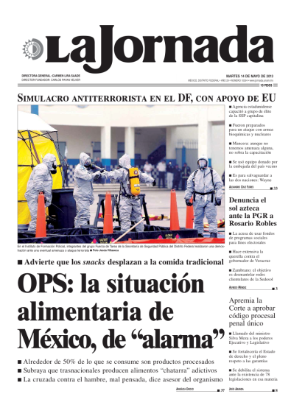

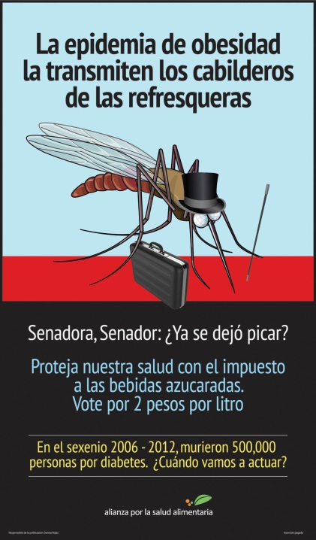
CAMPAIGN STRATEGY (2)
Media strategy: Create public debate through press conferences (1xweek), public actions/performances (1xmonth) and newspaper ads (2xweek in Oct.)
Engagement with decision-makers and lobbying:
  Actor mapping
  Identification of champion(s)
  Relationship building across parties, ministries and Congressional committees
  Mini public campaign targeting Congress
  Tracking industry lobbying (responding or exposing as necessary)
International support: WHO recommendations, PAHO, IASO/IOTF and other allied INGO’s, health advocates in the US

Slide 31
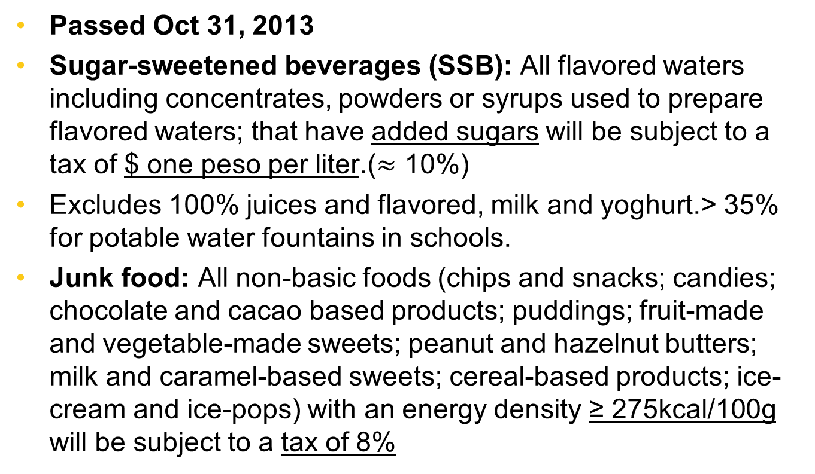
The Mexican Tax
Passed Oct 31, 2013
Sugar-sweetened beverages (SSB): All flavored waters including concentrates, powders or syrups used to prepare flavored waters; that have added sugars will be subject to a tax of $ one peso per liter.($≈$ 10%)
Excludes 100% juices and flavored, milk and yoghurt.> 35% for potable water fountains in schools.
Junk food: All non-basic foods (chips and snacks; candies; chocolate and cacao based products; puddings; fruit-made and vegetable-made sweets; peanut and hazelnut butters; milk and caramel-based sweets; cereal-based products; ice-cream and ice-pops) with an energy density ≥ 275kcal/100g will be subject to a tax of 8%

Slide 32
Factors of Success
Rationale for the tax & linking it to the cause: 70% of the public in favor of a tax linked to obesity/diabetes prevention, children & water fountains
Active and vocal academic community: “Obesity in Mexico” policy recommendations by National Academy of Medicine & INSP
Permanent public debate: Presence on the streets and every few days in national newspapers through campaigns, ads and earned media
Lobbying strategy: A “fearless” champion (Senator Marcela Torres), continuity and “Congress, Who’s side are you on?” campaign
Executive support: President Peña Nieto included the soda tax in his fiscal reform package; Ministry of Finance seeks revenue
“Lucky” political timing for legislative support: The Pact for Mexico favored passage of the fiscal reform package
Sufficient funding: For human resources & campaigning
Effective collaboration: Close coordination and synergy with civil society and academia in past year, possible due to past collaboration

Slide 33
Mexico (cont)
Evaluation of price, marketing, food purchase shifts underway led by INSP with UNC collaboration
To date it appears as if price increases are being
passed along
Future longitudinal analysis of impact on prices, marketing and food purchase patterns is being initiated

Slide 34
Mexico’s Critical Elements
Built up across medical and public health scholars over 5 years understanding of the role of sugary beverages so major consensus among most organizations, leaders in the field despite industry attempts to divide.
Built on major concerns about obesity, diabetes. Results of 2012 National Survey represented final statement.
Civil society very active against very aggressive Big Beverage campaign
Gov’t need for tax revenue but got part of SSB tax applied to potable water in schools.

Slide 35
4. Organizing options for review of major LMIC policy initiatives: NOURISHING framework
Developed by WCRF International (see Hawkes et al, A food policy package for healthy diets and the prevention of obesity and diet-related non-communicable diseases: the NOURISHING framework. Obesity Reviews. 2013; 14: 159-68.)
Focus on food: The website is updated continuously. Useful resource.
http://www.wcrf.org/policy_public_affairs/nourishing_framework/
Also many case studies on www.bellagioobesity2013.org

Slide 36
Focus on Key Elements of food system change
The food environment:
  Economic tools: prices, subsidies, trade controls
  Labeling: front-of-the-package approaches being used; claims restrictions
  Marketing controls and restrictions
  restrict foods in selected institutions(e.g. schools)
Food systems: retailing, restaurant/fast food sector, farm to fork systems
Information and education: large scale and counseling

Slide 37
The Food Environment: Economic Tools
Taxation and Subsidies
  Mexico(10% SSB,8% junk food), Pacific islands, Singapore: subsidize selected foods for schools, hawker centers.
  other countries now considering the SSB tax
  Ideally want a total sugar in beverages tax as most effective [tax per gram of sugar]
Import controls: problems with WTO emerged in Western Pacific Island work

Slide 38

Activities to Improve Diets
Country | Type of taxation | Size
French Polynesia | Excise and import tax on sugar-sweetened drinks, confectionaries, and ice cream | 40 CFP*/litre local tax; 60 CFP*/litre imported tax
Nauru | Sugar levy on all high-sugar foods and drinks and removal of a levy on bottled water | 30%
Cook Islands | Import duty on sugar-sweetened drinks | 15% with a subsequent 2% rise per year
Fiji | Import duty and local excise duty | 5% import duty; 5cents/liter local excise duty
Fiji | Excise on raw materials | 3%
Fiji | Import duty on palm oil and monosodium glutamate | 32%
Fiji | Import duty on fruits and vegetables not grown locally | Removal of existing taxes, which were 5–32%
Pacific Research Centre for the Prevention of Obesity and Non-communicable Diseases

Slide 39
The Food Environment: Labeling and Claims
Front-of-the-package—confusing GDA’s of industry vs.
  positive health food labeling: Singapore, Malaysia, Mex., Thailand in process, others considering.
  negative: Ecuador exists as law(now planning implementation with its own version of negative logo) and Chile(law passed, not implemented yet) identify foods with unhealthy levels added sugar, sodium, saturated fat;
  ban images: Ecuador banned animal characters, cartoon personalities, celebrities to promote junk food
Claims: mainly unfettered except Mexico’s attempt to remove (unsuccessful implementation with current President), few countries regulate well
Ideal link labeling with marketing and taxing

Slide 40

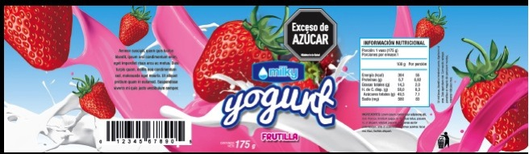
Labeling Un-healthy Foods
10 % of front surface of the package
One for each high “critical nutrient”

Slide 41
The Food Environment: Marketing Controls Hampered by Big Food and Beverage Politics
Chile: implementation of law to ban toys, control marketing of unhealthy foods high in saturated fat, add sugar and sodium stopped after became law
Brazil: comprehensive exemplary law held up by attorney general after passing legislature.
Peru: strong law not implemented yet
Industry voluntary self-regulation seems to be the major approach and no evaluation has shown this to be successful in any LMIC
South Korea: ban for TV and internet specific food categories during kids programs and 5-7pm

Slide 42
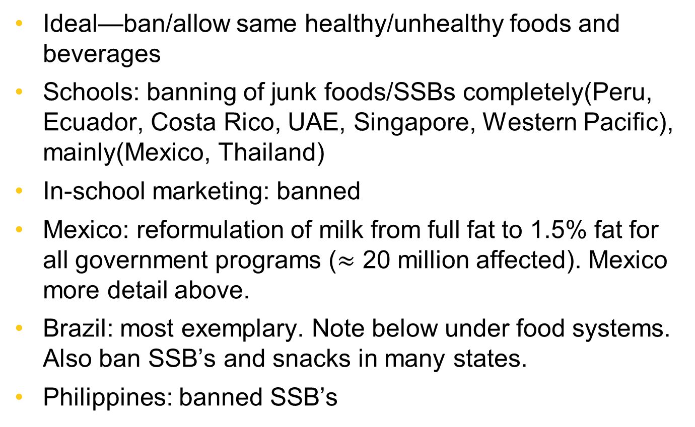
The Food Environment: School Restrictions Major Institution
Ideal—ban/allow same healthy/unhealthy foods and beverages
Schools: banning of junk foods/SSBs completely(Peru, Ecuador, Costa Rico, UAE, Singapore, Western Pacific), mainly(Mexico, Thailand)
In-school marketing: banned
Mexico: reformulation of milk from full fat to 1.5% fat for all government programs ($≈$ 20 million affected). Mexico more detail above.
Brazil: most exemplary. Note below under food systems. Also ban SSB’s and snacks in many states.
Philippines: banned SSB’s

Slide 43
Chile’s Law: Marketing to Children
Comprehensive approach: regulate all food marketing strategies such as package design, promotions, places of display, etc.
Address not only infant and childhood environments (schools, day care center, playgrounds) but also family environments (malls, TV shows, etc.)
Norms should focus on:
  television
  schools (directly and indirectly through advertisements within textbooks and educational materials)
  visual or audio placement in films, music videos, video games, the Internet, etc.

Slide 44
Brazilian Food Marketing Law
2006: Government attempt to regulate the advertising of foods high in sugar, sodium, saturated fat, and trans fat
  The resolution was challenged in court by representatives of the food industry and was suspended by the federal attorney general despite the commitment of the Health Ministry and the NHSA

Slide 45
Food Systems
Brazil: most effective but needs serious impact evaluation. Schools must purchase 30% of food from local smaller family farms/cooperatives. Also 70% of food must be a basic food. No idea of impact on overall diet of children let alone diet at schools.
Singapore: put all hawkers into centers when can control the environment, have access to them for various programs.
The push for farmers markets and farm to household sales minimal in LMIC’s (a high income country phenomena mainly)
Urban and school gardening: limited systematic efforts
Mainly ignoring retail sector and restaurant/fast food other than the Singapore effort and the front of the package labeling efforts

Slide 46
Information and Education
Large-scale: Thailand unique effort at the village level with a focus on reducing waist circumference(flat belly network), also reduce sugar and fat
Dominant effort: food-based dietary guidelines and classic nutrition education
Nutrition education in schools in many countries pushed. No focus on cooking or other skills
Few countries push for healthy food hospitals and clinical diet and physical activity counseling (e.g. Brazil, Thailand)
Workplace: limited efforts (e,g Singapore)

Slide 47


Special Programs for Controlling Overweight
and Obesity Problems
Sweet enough network
Thai people flat belly network

Slide 48
LMIC’s are Beginning to Take
Serious Large-scale Action
While only a few countries (e.g. France, Scandinavian) take major actions among the high income countries, the need and the will to take action is increasing among LMIC’s
Mexico, Ecuador, Thailand, Singapore, the Western Pacific Islands are just the beginning of this.
Need to learn to work more with civil society groups to aid in the battles with big food and big beverage.
Evidence is needed: serious push for rigorous evaluation is essential.
A need to create one food and beverage standard and use across all controls: marketing, front-of-packing profiling, taxation

