Slide 1
Global Sugar Consumption Patterns, Policies, Taxes, and Other Issues
Barry Popkin
W. R. Kenan, Jr. Distinguished University Professor
Department of Nutrition
Gillings School of Global Public Health
School of Medicine
Department of Economics
The University of North Carolina at Chapel Hill

Slide 2
Outline: Why is This Occurring?
In-depth look first: added sugar in modern food supply, the ignored role of fruit juice concentrate and fruit juice as major added sugars in food and beverages with all the ‘natural healthy organic’ connotations and lack of measurement of dynamic additions of added sugar to our food supply
US Added sugar intake and an ignored issue: maldistribution of intake of added sugar
Global consumption patterns
Diet sweetener patterns and trends
Policies being utilized: taxes, labeling, marketing controls, restrictions in selected environments

Slide 3
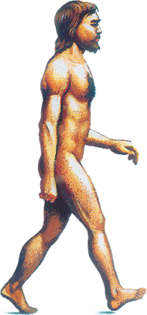
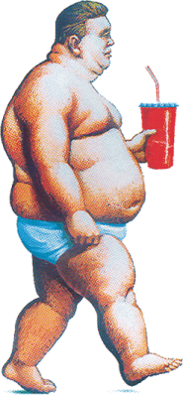
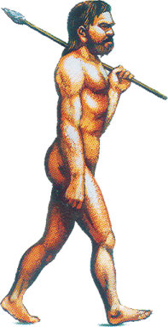
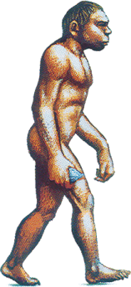
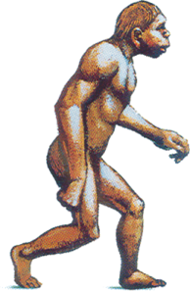
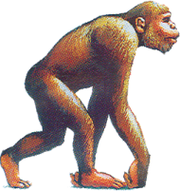
Remarkably Short History for Caloric Beverages:
Might the Absence of Compensation Relate to This Historical Evolution?
Earliest possible date
Definite date
US Soda Intake 52/gal/capita
(2004)
US Coffee Intake 46 gal/capita
(1946)
Juice Concentrates (1945)
US Milk Intake 45 gal/capita
(1945)
Pre-Homo Sapiens
200,000BCE - 10,000 BCE
Origin of Humans
Modern Beverage Era
10,000 BCE - present
Coca Cola (1886)
Pasteurization (1860-64)
Carbonation (1760-70)
Liquor (1700-1800)
Lemonade (1500-1600)
Coffee (1300-1500)
Brandy Distilled (1000-1500)
Tea (500 BCE)
(206 AD)
Wine, Beer, Juice
Wine (5400 BCE)
(8000 BCE)
Beer (4000 BCE)
Water, Breast Milk
Milk (9000 BCE)
2000 BCE
200000 BCE
Homo Sapiens
100000 BCE
Beginning
of Time
200000 BCE
10000 BCE
0
BCE
AD

Slide 4
1. Sweeteners in Our Food Supply
About 550,000 foods and beverages exist in our consumer packaged food and beverage system in
the US.
About 100,000 have unique ingredients. Using these data from a nationally representative sample of about 60,000 households who daily scan all food purchases’ bar codes, we can identify the foods with sweeteners.
Two sets of data—older published paper on difference from US NHANES data and our data with ingredients searched.
Then new results—in press only

Slide 5
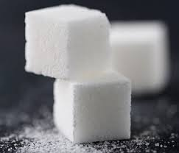
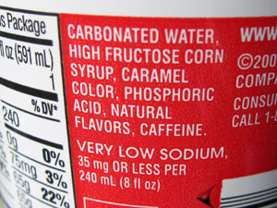
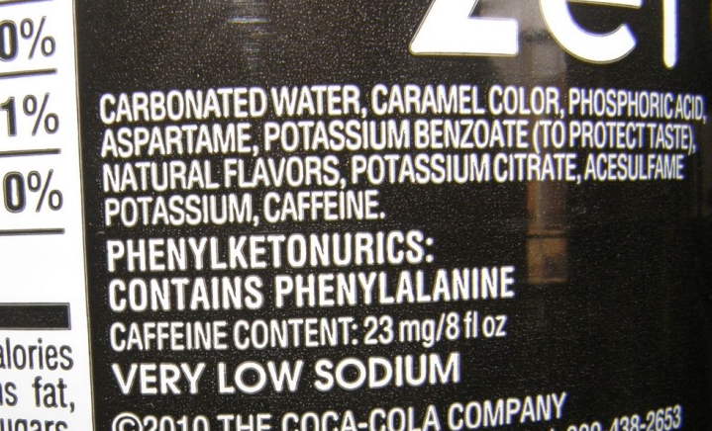
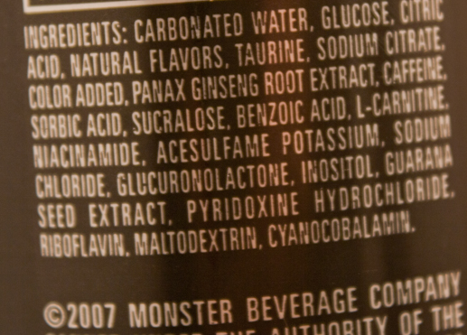
Sweeteners in Our Food Supply
Key word searches at the ingredient list of each product
  Low-calorie sweeteners: artificial sweetener, aspartame, saccharin, sucralose, cyclamate, acesulfame K, stevia, sugar alcohols (i.e. xylitol) and brand name versions of each sweetener (i.e. Splenda)
  Caloric sweeteners: fruit juice concentrate (not reconstituted), cane sugar, beet sugar, sucrose, glucose, corn syrup, high fructose corn syrup, agave-based sweeteners, honey, molasses, maple, sorghum/malt/maltose, rice syrup, fructose, lactose, inverted sugars
Caloric Sweetener
Low-calorie Sweetener

Slide 6
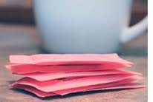
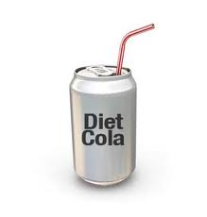
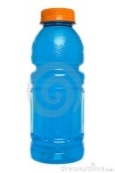
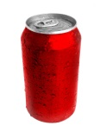
Sources of Sweeteners
Caloric sweetener
Low calorie sweetener
LCS and CS
All Foods and Beverages that Contain Any Sweetener
Means per capita for beverages (mL/d) and foods (g/d). LCS, low-caloric sweetened beverages or foods; CS, caloric-sweetened beverages or foods
Piernas et al, Pediatrics Obesity 8:294-306

Slide 7
The % of Uniquely Formulated Foods and Beverages in the US Food Supply Containing Sweeteners (Mutually Exclusive Categories)
NS= Nutritive/Caloric Sweetener, NNS= Non-nutritive/non-caloric sweetener, FJC= Fruit Juice Concentrate (excluding lemon/lime and when reconstituted) (not for use or quotation) (Popkin and Hawkes, Lancet Diabetes for fall/winter)
Notes:
Note the enormous increase in the number of products, eg almost doubling 2006-2013

Slide 8
% of Uniquely formulated CPG Purchases by Weight in Grams
Containing Sweeteners (Weighted to Be Nationally Representative)
NS= Nutritive/Caloric Sweetener, NNS= Non-nutritive/non-caloric sweetener, FJC= Fruit Juice Concentrate (excluding lemon/lime and when reconstituted) (not for use or quotation) (Popkin and Hawkes, Lancet Diabetes for fall/winter)
Notes:
Based on step 1-4 Purchase-NFP links

Slide 9
% of CPG Purchases by Calories Containing Sweeteners Weighted to be Nationally Representative (Excludes Low Calorie Sweeteners by Using Kcal)
NS= Nutritive/Caloric Sweetener, NNS= Non-nutritive/non-caloric sweetener, FJC= Fruit Juice Concentrate (excluding lemon/lime and when reconstituted) (not for use or quotation) (Popkin and Hawkes, Lancet Diabetes for fall/winter)
Notes:
Based on step 1-4 Purchase-NFP links

Slide 10
2. United States: Added Sugar and Beverages:
Patterns and Trends
US trends overall
Changes in the distribution

Slide 11
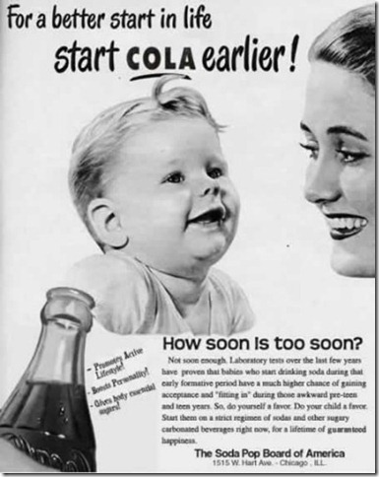
Hook consumers early, gain a
consumer for life:
“Babies who drink soda during their early formative period are much more likely to fit in during those awkward preteen and teen years”
Notes:
Babies who drink soda during their early formative period are much more likely to fit in during those awkward preteen and teen years

Slide 12
Adjusted Mean Calories of Daily Added Sugars by US Individuals for Foods and Beverages
1977 to 2003 change
Beverages:+3.6kcal/year
Foods: +.6kcal/year
2003 to 2012 change
Beverages:-5.6 kcal/year
Foods: -1.2 kcal/year
1977 to 2003 change
Beverages:+3.5kcal/year
Foods: +.9kcal/year
2003 to 2012 change
Beverages:-3.9 kcal/year
Foods: -.3kcal/year
Children 2-18
Adults 19 and Older
Adjusted by Gender, Race, Income and Education, Weighted to Be Nationally Representative

Slide 13
Trends in Quintiles of Added Sugar Distribution in the US
(Excludes Fruit Juice Concentrate), Kcal/Day.
Note the large skewed distribution.
A. Children aged 2-18
B. adults 19 and older
q1
q2
q3
q4
q5
Powell et al, (not for use or quotation)

Slide 14
3. Global Trends— Both in Kcal by Region and Country and Volume
Euromonitor passport data: excellent on trends, levels appear to be under-reported as expected as they do not obtain data from all companies. Pilot study worked with them. they obtain kcal from each country for most beverages.
Kcals based on calories from beverages in each country. They get this off websites and nutrition facts panels. If anything, these are a major undermeasurement as many local companies underreport their kcal, total sugar and other data.

Slide 15
Daily Calories Sold per Capita per Day from all Sugar-Sweetened Beverages in 2014 by Region (Weighted by Population)
Source: Euromonitor Passport International with country-specific kcal data added (not for use or quotation) (Popkin and Hawkes, Lancet Diabetes for fall/winter)

Slide 16
Caloric Trends in Sugar-Sweetened Beverage Sales by Region, 2009-2014
Source: Euromonitor Passport International with country-specific kcal data added (not for use or quotation) (Popkin and Hawkes, Lancet Diabetes for fall/winter)

Slide 17
Calories Sold per Capita per Day from Sugar-Sweetened Beverage by Country, 2009-2014
Source: Euromonitor Passport International with country-specific kcal data added (not for use or quotation)

Slide 18
Supplemental Figure 1. Daily Calories Sold per Capita from all
Sugar-Sweetened Beverages in 2014, Highest Selling Countries
Source: Euromonitor Passport International with country-specific kcal data added (not for use or quotation) (Popkin and Hawkes, Lancet Diabetes for fall/winter)

Slide 19
Daily Calories Sold per Capita from all Sugar-Sweetened Beverages in 2014, Lowest Selling Countries
Source: Euromonitor Passport International with country-specific kcal data added (not for use or quotation) (Popkin and Hawkes, Lancet Diabetes for fall/winter)

Slide 20
Trends 2000-2010 in Calories per Ounce Sold:
Global, the US, Brazil, and China
World
US
Brazil
China
Source: Kleiman et al (2011) Obesity Reviews

Slide 21
Brazilian Trends 2000-2010 in Daily Calories
Bottled Water
Carbonates
Fruit/Vegetable Juice
Sports and Energy Drinks
Source: Kleiman et al (2011) Obesity Reviews

Slide 22
Chinese Trends 2000-2010 in Daily Calories
Source: Kleiman et al (2011) Obesity Reviews

Slide 23
Volume (mL) Trends in Sugar-Sweetened Beverage Sales per Capita per Day in China, 2000-2014
Source: Euromonitor Passport International with country-specific kcal data added (not for use or quotation) (Popkin and Hawkes, Lancet Diabetes for fall/winter)

Slide 24
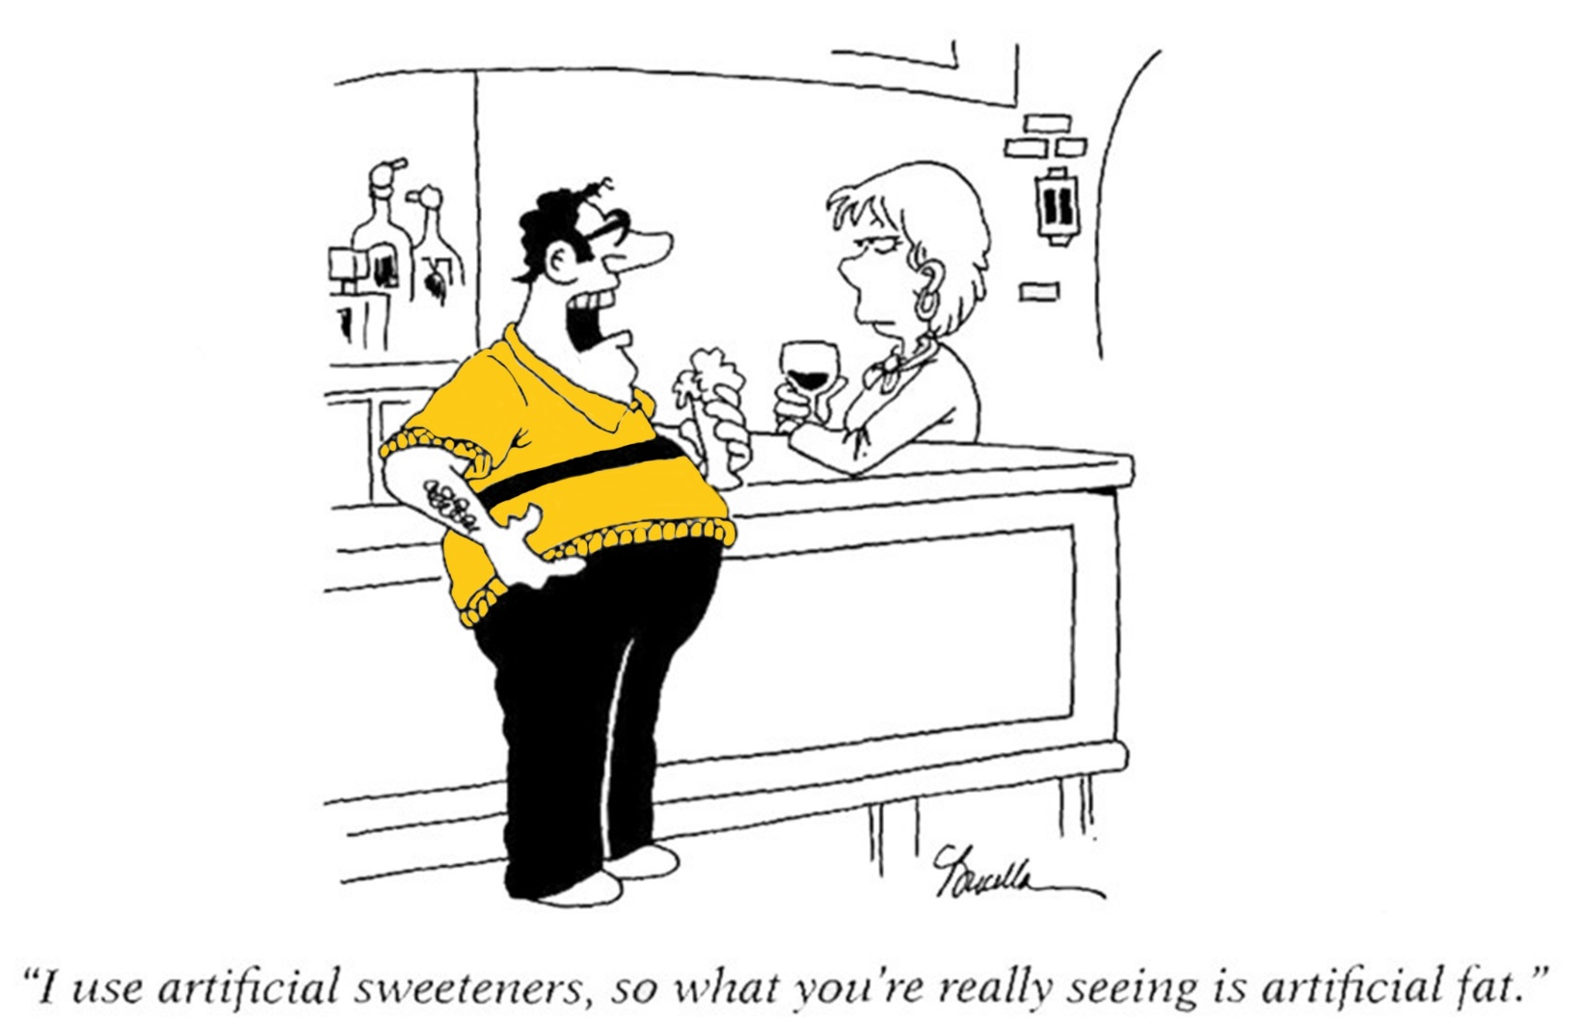

Slide 25
4. Low-caloric Sweeteners
(Diet Sweeteners but with a few Kcals)

Slide 26
Examples of Major Low Calorie Sweeteners Used in Diet Beverages (Now Dozens of Low Calorie Sweeteners)
Sweetened diet beverages: Complex. Our work in process suggests it is the diet linked with these beverages that determines the effect and not the diet beverages (see Mattes and Popkin, AJCN (2009) 84)
Acesulfame K (Sunett)—approved 1988
Aspartame (Nutrasweet, Equal)—approved 1981
Cyclamate - approved1958
Saccharin (Sweet’n Low)—approved 1977
Sucralose (Splenda)—approved 1998
Neotame (Nutrasweet manufactured)—approved 2002
Stevia (Truvia)—approved 2008

Slide 27
Liters of Diet Beverages Sold per Capita in 2014 by Region
(not for use or quotation) (Popkin and Hawkes, Lancet Diabetes for fall/winter)

Slide 28
mL of Diet Beverages Sold per Capita per Day by Region, 2000-2014
(not for use or quotation) (Popkin and Hawkes, Lancet Diabetes for fall/winter)

Slide 29
Trends in Diet Beverage US Among US adults(≥19), 1977-2008
Year | Grams per capita | % of pop. Consuming | mL per consumer
1977-78 | 26 | 8.3 | 311
1989-91 | 55 | 13.4 | 410
1994-98 | 111 | 23.3 | 477
2003-2004 | 163 | 26.8 | 609
2005-6 | 184 | 30.6 | 602
2007-8 | 176 | 28.4 | 620
2009-10 | 147 | 28.0 | 527
2011-12 | 127 | 24.2 | 524
Source: nationally representative NHANES data

Slide 30
Trends in Diet Beverage US among US Children(2-18), 1977-2008
Year | Grams per capita | % of pop. Consuming | mL per consumer
1977 | 11 | 4.9 | 226
1989-91 | 17 | 6.1 | 276
1994-98 | 33 | 12.0 | 278
2003-2004 | 40 | 12.8 | 315
2005-6 | 38 | 15.3 | 246
2007-8 | 43 | 16.1 | 265
2009-10
2011-12
Source: nationally representative NHANES data

Slide 31
Large-Scale Regulatory Options
Taxation of sugar - ideal, very unlikely
Taxation at the manufacturer level of kcal in SSB’s
Marketing controls
Front-of-the-label profiling linked with marketing controls
Controls in selected institutions, e.g. schools
Food system changes

Slide 32
Taxation
Egypt: SSB taxes: 25%, low consuming, no evaluation; Barbados 10% tax begins Aug 1, 2015
France and Mexico SSB: about 10% tax, Mexican evaluation strong positive results but cannot reveal details until we publish. On website showed release: . Preliminary results show a 6 percent average decline in purchases of taxed beverages over 2014 compared to pre-tax trends. This difference accelerated over 2014 and the reduction compared to pre-tax trends reached 12% by December 2014. All socioeconomic groups reduced purchases of taxed beverages. Reductions were higher among lower socio-economic households, averaging 9% decline over 2014 compared to pre-tax trends and up to a 17% decline by Dec 2014. Results also show roughly a 4 percent increase in purchases of untaxed beverages over 2014, mainly driven by an increase in purchased bottled plain water (tap water intake is not collected).
Hungary—no evaluation
Chile: 8% SSB began Jan 1, 2015 coupled with marketing and FOP controls which will slowly be instituted over 4 years. Will work on rigorous evaluation
Selected Pacific Islands

Slide 33
The Food Environment:
Labeling and Claims
Front-of-the-package—confusing GDA’s of industry vs.
  positive health food labeling: Singapore, Malaysia, Mexico, Thailand, China have or are finalizing. India is beginning. Law in Netherlands/Czech/others E Europe, Scandanavian Tick, new Health Stars Australia and New Zealand
  negative logo: Ecuador exists as law (now planning implementation with its own version of negative logo) and Chile (law passed, not implemented yet) identify foods with unhealthy levels added sugar, sodium, saturated fat.
    Complex traffic lights. Negative on multiple items.
  ban images: Ecuador banned animal characters, cartoon personalities, celebrities to promote junk food.
Ideal: Link labeling with marketing and later taxation.
Some countries are doing this.

Slide 34

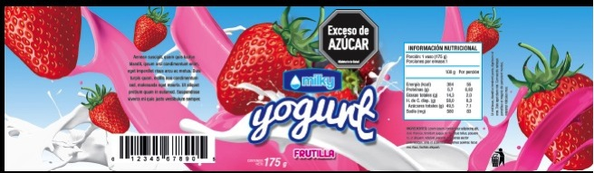
Labeling Unhealthy Foods
10 % of front surface of the package
One for each high “critical nutrient”

Slide 35
The Food Environment: Marketing Controls Hampered by Big Food and Beverage Politics
Chile: implementation of law to ban toys, control marketing of unhealthy foods high in saturated fat, add sugar and sodium in all media channels; a 3-year implementation in phases begins July 1, 2016.
Brazil: comprehensive exemplary law held up by attorney general and legal challenges
Peru and Ecuador: strong laws, implementation not complete
Industry voluntary self-regulation seems to be the major approach and no evaluation has shown this to be successful in any LMIC or any high income country.
South Korea: ban for TV and internet specific food categories during kids’ programs and 5-7pm.
Thailand planning marketing ban linked with FOP labeling

Slide 36
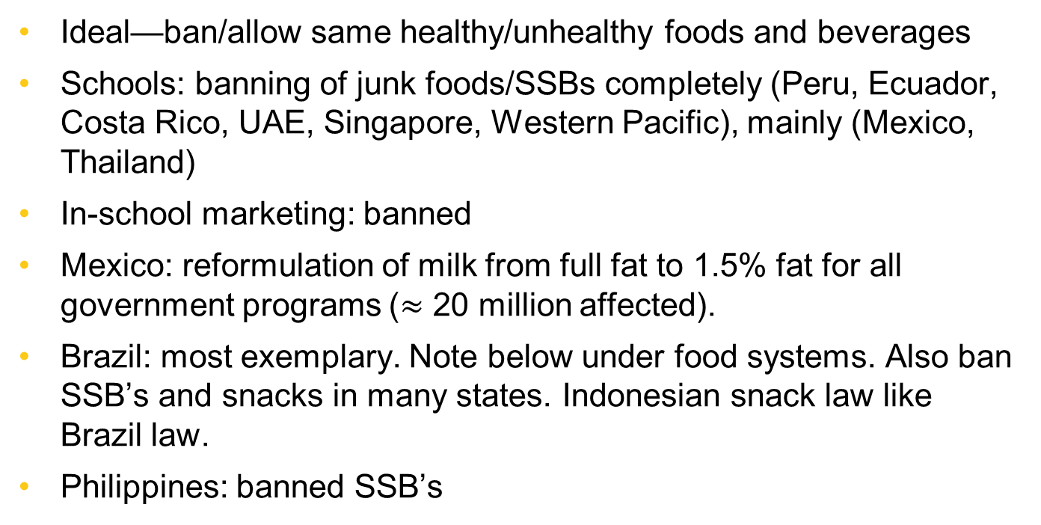
The Food Environment: School Restrictions Major Institution
Ideal—ban/allow same healthy/unhealthy foods and beverages
Schools: banning of junk foods/SSBs completely (Peru, Ecuador, Costa Rico, UAE, Singapore, Western Pacific), mainly (Mexico, Thailand)
In-school marketing: banned
Mexico: reformulation of milk from full fat to 1.5% fat for all government programs ($≈$ 20 million affected).
Brazil: most exemplary. Note below under food systems. Also ban SSB’s and snacks in many states. Indonesian snack law like Brazil law.
Philippines: banned SSB’s

Slide 37
Food Systems
Brazil: most effective but needs serious impact evaluation. Schools must purchase 30% of food from local smaller family farms/cooperatives. Also 70% of food must be a basic unprocessed food. No evaluation so unclear impact.
Singapore: put all hawkers into centers when can control the environment, have access to them for various programs.
The push for farmers markets and farm to household sales minimal in LMIC’s (a high income country phenomena mainly)
Urban and school gardening: limited systematic efforts
Mainly ignoring retail sector and restaurant/fast food other than the Singapore effort and the front of the package labeling efforts

Slide 38
Information and Education
To date no evidence from any country that large-scale nutrition education has affected either what people eat or drink or how they move. Thailand appears the strongest.
Large-scale: Thailand unique effort at the village level with a focus on reducing waist circumference (Flat Belly Network), also reducing sugar and fat
Dominant media today: food industry and retailers and food service sector. Trivial level of public health-related nutrition education
Nutrition education in schools in many countries pushed. No focus on cooking or other skills and minimal impact shown to date.
Few countries push for healthy food in hospitals and clinical diet and physical activity counseling (e.g. Brazil, Thailand)
Workplace: limited efforts (e.g. Singapore)

Slide 39

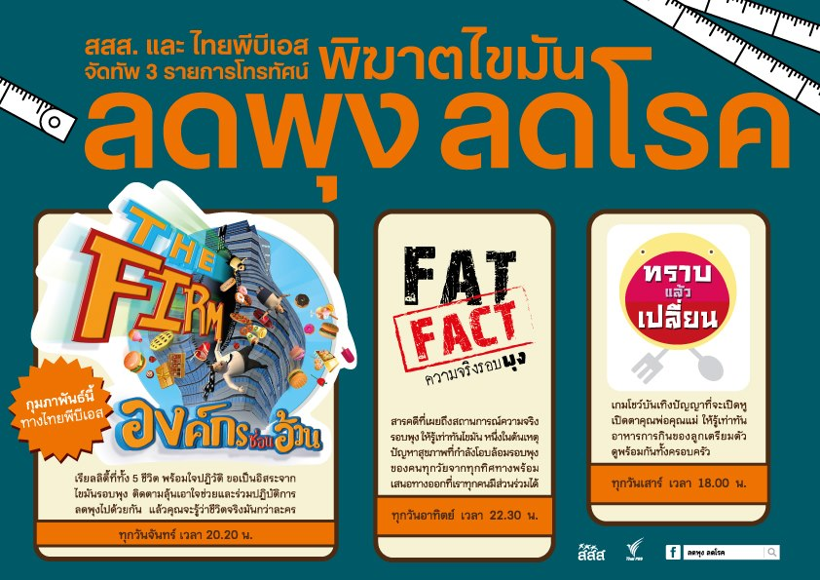
Special Programs for Controlling
Overweight and Obesity Problems
Sweet Enough Network
Thai People Flat
Belly Network

Slide 40
LMIC’s Are Beginning to Take
Serious Large-Scale Action
The need and the will to take action is increasing among LMIC’s
Mexico, Ecuador, Chile, Peru, Thailand, Singapore, and the Western Pacific Islands are just the beginning of this.
Evidence is needed: serious push for rigorous evaluation is essential.
A need to create one food and beverage standard and use across all controls: marketing, front-of-packing profiling, taxation

