Slide 1
Links between Transformation of the agrifood system and transformation of diets and diet-related health concerns in Latin America and Asia
Barry Popkin
W. R. Kenan, Jr. Distinguished University Professor
Department of Nutrition
Gillings School of Global Public Health
School of Medicine
Department of Economics
The University of North Carolina at Chapel Hill

Slide 2
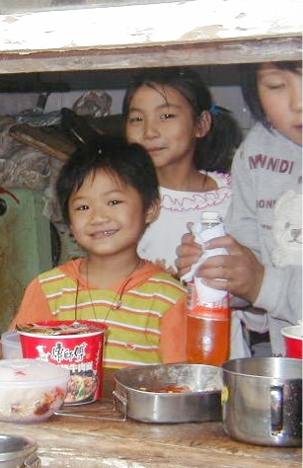

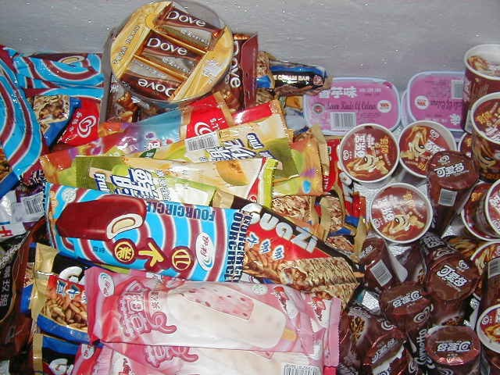

Chinese Children’s Diets are
Changing Fast in the 2000’s

Slide 3
Outline: Why is this occurring?
3 sets of forces underlying:
--Agricultural system: history with its older nutrition goals, impact within the context of modern health and nutritional needs
--modern technology: biological mismatch
--agrifood system shifts in the past 25 years
Physical activity decline: major cause, not a solution
Latin American change: precursor of changes seen in Asia, Africa. The Mexican case
China’s diet transformation and role of current agrifood system—impact on diet and risk of obesity
Now double burden countries face agrifood system both problems

Slide 4
I.Modern global food system: postWWII
Focus first on basic grains [corn, wheat,etc] and cash crops and then animal source foods
At that point feeling globally that animal protein was a critical need to have a healthy diet. No sense of the role of beans, fruit and vegetables
Jointly worked to create a global system as see in the next slide and shifted relative prices toward cheaper grains, sugar, later oils, animal source foods globally.

Slide 5
Stages of Global Agricultural System’s Development
Scientific and technological change, economic change, urbanization, globalization
Pattern 1
1800’s mainly
Scientific underpinnings
Pattern 2
1900-1944
Pattern 3
Post WWII massive investments modern system
Pattern 4 Transmission system to the globe
(1955-2008)
Pattern 5
The commercial sector shifts major drivers of system change (present)
Pattern 6 Healthier food supply
Science and
institution building
Expansion technologies,
science
Create modern food system focused on staples, animal source foods, cash crops
Create global farm research-extension system and education mirroring that of the west
Retailers,agro-input & agriprocessing, businesses, food manufacturers begin
to dominate farm-level decision-making
Price incentive, taxation, system investments
Fossil energy
modern genetics,
fertilizer, beginning
Agricultural science and experimental
work, & land grant/ag universities
Expansion of science, develop reaper, many other technologies
Trillions for major infrastructure, system, input and enhanced seeds, technology development embraced
Investment training, institutions, infrastructure, CGIARG
Direct farm linkages to drive production /marketing decisions
Major shift in incentive system and economic drivers
Price incentive /taxation/ investments in infrastructure and training
Europe, the US, Japan, other higher income countries rapid mechanization, development of new food processing technologies (e.g.. Extraction of edible
oils from oilseeds,),
investment in transportation/ irrigation/
electrification/ modernization of agriculture
Farming remains the major source food supply; initiated Industrial/large-scale monoculture
Farming systems developed, underpinnings post WWII revolution
added modernization of agricultural production inputs, machinery
The green revolution, major irrigation/ credit/ farm extension/ agricultural institutions mirroring the west, further modernization of food processing
Shift to production linked to needs of food manufacturers, retailers, ignoring climate/sustainability/ health concerns
Diet shifts linked with reduced NCD’s, reduced climate footprint, total sustainability, reduced animal source foods
Low fertility, low
life expectancy
Source: © (copyright) Barry M. Popkin, 2015

Slide 6
II. Mismatch: Biology which has evolved over the millennia clashes with modern technology
Biology | Technology
Sweet preferences | cheap caloric sweeteners, food processing benefits
Thirst and hunger/satiety mechanisms not linked | Caloric beverage revolution
Fatty food preference | Edible oil revolution-high yield oilseeds, cheap removal of oils, modern processed food/restaurant sector
Desire to eliminate exertion | Technology in all phases of movement/exertion

Slide 7
Mismatch (continued)
Technology not only as noted above but marketing forces unleashed globally by food industry and enabled moreover by WTO
Created behaviors: snacking, portion pricing, economies of scale in selling bigger food/beverage sizes, etc
WTO: pushed to speed up technology transfer and forced countries to compete in ways rationalized many food sectors and drove down many prices.

Slide 8
III.Modern agrifood system
Retailer and food service sector growth exponential
Penetration very deep—villages of Mexico.
Modern technology has sped up enormously the speed of transfer of any new successful food or beverage globally. For example, consider coke vs Red Bull.

Slide 9
IV.Modern Technology: Energy Imbalance: Physical Activity declines in LMIC’s represent a significant, large component of increased energy imbalance.
In countries with detailed longitudinal data on all components of physical activity we find very large declines in METS and any other measure of activity
The MET concept represents a simple, practical, and easily understood procedure for expressing the energy cost of physical activities as a multiple of the resting metabolic rate. “MET” is another name for metabolic equivalent; a measure of exercise intensity based on oxygen consumption.
Slow downward shift in high income countries starting from much lower starting point relative to high METS starting point and very steep decline in LMICs
See review across a number of low-and high-income countries by Ng and Popkin Obes Rev (2012) 13 (8):659-80 (next two slides)

Slide 10
US Adults Met-hours Per Week of All Physical Activity, and Hours/Week of Time in Sedentary Behavior: Measured for 1965-2009 and Forecasted for 2010-2030
Source: Ng S.W. & Popkin B.M. Obesity Reviews (2012) 13 (8):659-80

Slide 11
Chinese Adults Met-hours per Week of Physical Activity & Hours/Week of Time in Sedentary Behavior: Measured for 1991-2009 and Forecasted for 2010-2030
1991: 399 MET-hr/week
Source: Ng S.W. & Popkin B.M. Obesity Reviews (2012) 13 (8):659-80

Slide 12
V. Latin America: the Mexican case
One of the highest overweight and obesity levels globally.
Very rapid diabetes increase, occurring among younger Mexicans than found in high income countries.
Linked with rapid increases in kcal from caloric beverages, snacking (over a first of kcal), and processed food.

Slide 13
Todays processing and purposes: amazingly complex
Extent & Purpose of Processing | Definition | Examples
Minimally processed food | Single ingredient basic foods with no or very slight modifications that do not change inherent properties of the food | Fresh, frozen, or dried plain fruits, vegetables, roots, tubers, or legumes; unsalted nuts and seeds; fresh or frozen unseasoned meats; eggs; plain milk; grains; coffee beans; tea leaves; bottled water
Moderately processed ingredient | Extraction or purification of one specific component of a single basic food using physical and chemical processes that change inherent properties of the food | Oil, sugar, flour, spices, 100% juice, butter
Moderately processed for preservation or pre-cooking | Physical and chemical processes applied to minimally processed foods for the purpose of preservation or pre-cooking that do not change the basic nature of the food | Canned fruit, vegetables, legumes, meat, poultry, or seafood; plain yogurt; cheese; instant oatmeal; instant rice; plain peanut butter
Moderately processed for flavor | Addition of moderately processed ingredients to a minimally or moderately processed food, combined for the purpose of enhancing flavor but not changing the basic nature of the food | Frozen, dried, or canned fruit with sweeteners; salted nuts and seeds; fresh or frozen meat or seafood with seasoning; flavored milk; flavored yogurt; flavored oatmeal; tuna canned in oil; sweetened juice
Moderately processed grain products | Combination of grains or flour with water, salt, and/or yeast to convert grains into grain-based products | Taco shells/tortillas, bread, plain pasta, basic cereals (puffed rice, shredded wheat, plain flakes)
Ultra-processed ingredient | Multi-component mixture of combined ingredients not resembling its basic components but NOT consumed alone | Margarine, mayonnaise, condiments, dips, salad dressings, jam/jelly, sauces, gravy
Ultra-processed food | Multi-component mixture of combined ingredients not resembling its basic components and consumed alone | SSBs, cookies, frozen entrees, pizza, canned soup, processed meat, salty snacks, ice cream, dessert mixes, boxed or canned mixed dishes, candy

Slide 14
Of 1.2 million US barcoded foods and beverages with unique ingredients, % calories purchased by processing level
highly-
processed
Processed
Moderately
processed
Minimally
processed
*
*
*
*
*
*

Slide 15
Of 1.2 million US barcoded foods and beverages with unique ingredients,% calories purchased by convenience level
Ready-to-eat
Ready-to-heat
or minimal
Preparation
Requires
cooking
and/or
preparation
*
*
*
*

Slide 16
Packaged and Processed food consumed in Mexico, 2012
In Ensanut 2012 we asked each person with 24-hour recall if the food was consumed not raw, came from a packaged item, had the word industrial in the title or the nutrient data came from the nutrition labeling on the package. All were considered packaged and processed.
Popkin (2014) Food Policy,47:91-96

Slide 17
Packaged and Processed Food is high across all areas of Mexico, Ensanut 2012
Source: The Mexican National Nutrition Survey, 2012
Popkin (2014) Food Policy,47:91-96

Slide 18
The six food groups account for half of all kcal in Mexico from packaged and processed foods and beverages*
Dairy-soy beverages | 6.8%
Tortillas | 14.1%
Grain-based desserts/sweet breads | 10.5%
Salty snacks | 2.1%
Meat/poultry/fish/eggs | 3.1%
Sugar-sweetened beverages | 3.8%
*Proportion of total kcal from packages and processed foods and beverages
from National Nutrition Survey, 2012 for ages 2 and older
Popkin (2014) Food Policy,47:91-96.

Slide 19
VI.China Health and Nutrition Survey
China Health and Nutrition Survey: Like Mexico, asked for each food consumed if it was packaged and processed in some way.
Controlled for selectivity but used only CHNS2011 so cross-sectional. Zhou et al, (2015) Food Policy 55: 92-100

Slide 20
Purchase of Consumer Package Foods and Beverages are
Increasing Rapidly! In China, in 2011 we asked in 3 Days of
Daily 24-hr Recall about the Source of Each Food Item.
Source: The China Health and Nutrition Survey, 2011
Popkin (2014) Food Policy,47:91-96
Big cities: 5-20 million; mega cities: > 20 million-Shanghai, Beijing, Chongqing

Slide 21
Factors Associated with the relationships between Purchasing Packaged Processed Foods in China and kcal/day,
CHNS 2011
(Additional 1000 kcal/day of Purchases of Processed Food)
Consumption of Processed Foods
Zhou et al, (2015) Food Policy 55: 92-100

Slide 22
The Effect of an Additional 1000 kcal Increase in Predicted Daily Processed Food Consumption on the Risk of Being Overweight and the BMI Level, CHNS2011
Linked with a significant increase in BMI(for 1000 kcal processed food) by 1.32 unit only in those aged 2-18, not adults or elderly. Also linked with significant increase in the risk of overweight and obesity by 39%.
Instruments were: distances from household to various markets (fresh markets, convenience stores, supermarkets). Processed food purchases (kcal) was endogenous for kids only. We performed endogeneity tests to determine if the endogenous regressors are in fact endogenous (Durbin score and Wu-Hausman) and overidentifying restriction tests to determine if the instruments are valid (Sargan score and Basmann).
Zhou et al, (2015) Food Policy 55: 92-100

Slide 23
Source: Ng and Dunford Obes Revi(2013). Euro monitor Global Market Information Database.

Slide 24
Opportunities with the modern food sector
A major scientific question: can we create healthy processed and packaged foods that will be less obesogenic. They can sell healthy or unhealthy food and make a profit
Many scholars feel we must go back to eating real foods but minimal evidence. With our high levels of inactivity we can gain weight and waist circumference with any type of food
So the critical issue is: with the existing food system and considering its very rapid growth what can we do?

Slide 25
Can we reform the retail food sector?
So how do we use regulations and other incentives, taxes, information options to ensure healthy reformulation and healthy food purchases?
Challenges: marketing of unhealthy foods and beverages (billions of Yuan). Globally countries are working to control, focus on healthy food marketing
Shifting relative costs: taxation mainly of unhealthy foods and beverages (Mexico)
Globally countries are working to create simpler front-of-the package labels
Requirement of selected fruits and vegetables with set proportion of space in smaller stores

Slide 26
Food labeling: future directions
Nutrition facts panels are necessary. But for very few do they affect behavior and lead to healthy choices
Front of the package profiling: positive focus on labeling only healthy foods (e.g. low sodium, low added sugar, minimal unhealthy saturated fats, more whole grains, fruit and vegetables, pulses/legumes) that follow WHO and global nutrition knowledge. Or a negative logo that highlights excessive sodium, unhealthy fats, added sugar(e.g Chile).
To date, the positive logo only has been linked with product reformulation, some impact on purchasing.

Slide 27
Away-from-home food service sector
Fast food and stalls: few efforts but minimal outside of Singapore’s creation of hawker centers where can educate, control behavior of stalls
Portion size controls, pricing only beginning to understand how to get calorie labeling of fast food chains or restaurants with more than six in the chain to do this.

Slide 28
Low and middle income countries
Many are beginning to be world leaders in this arena but more related so far to sugar-sweetened beverage and junk food taxes (Mexico 10% SSB,8% junk food; Chile,8% SSB; Barbados, many others coming soon)
Many countries pushing marketing controls and positive or negative Front-of-the-package logos(Chile most inclusive with lagged initiation)
Great promise but rigorous evaluations are needed such as we are doing with Mexico as programs and policies emerge. Taxes work very successfully in middle income Mexico but low level, modest impact
To date no success stories of turning back the rapid increases in both BMI and waist circumference

